Slide 1
Digital Portfolio
STUDENT NAME: PRANESH
REGISTER NO AND NMID: 2422k1892 and asbru062422k1892
NM ID:1474748869468709076486F4A064D43E
DEPARTMENT: BSC
COLLEGE: Chikkanna Government Arts College /BharathiarUniversity

Slide 2
PROJECT TITLE
Student Digital Portfolio using front end development

Slide 3


AGENDA
Problem Statement
Project Overview
End Users
Tools and Technologies
Portfolio design and Layout
Features and Functionality
Results and Screenshots
Conclusion
Github Link
3/21/2024 Annual Review

Slide 4

PROBLEM STATEMENT
Many students and freshers don’t have a proper platform to showcase their skills, projects, and achievements. A digital portfolio solves this by giving a single place to present all the information in a professional way.

Slide 5

PROJECT OVERVIEW
This project is a personal digital portfolio website for me. It highlights my profile, skills, projects, and contact details. The goal is to make it easier for recruiters, teachers, and others to understand my capabilities.

Slide 6

WHO ARE THE END USERS?
Recruiters/Companies College faculty Friends and peers Anyone interested in my work

Slide 7

TOOLS AND TECHNIQUES
HTML, CSS, JavaScript – for website design and interactivity VS Code – for coding GitHub – for hosting/sharing CodePen (for testing small projects)

Slide 8
POTFOLIO DESIGN AND LAYOUT
Simple and clean design Color palette (red + blue) Sections: Home, About, Skills, Projects, Contact Responsive layout (works on mobile and desktop)
8

Slide 9
FEATURES AND FUNCTIONALITY
Smooth navigation bar Typing animation in Profile section Projects section with clickable links Flip card for email contact Contact form for easy communication

Slide 10
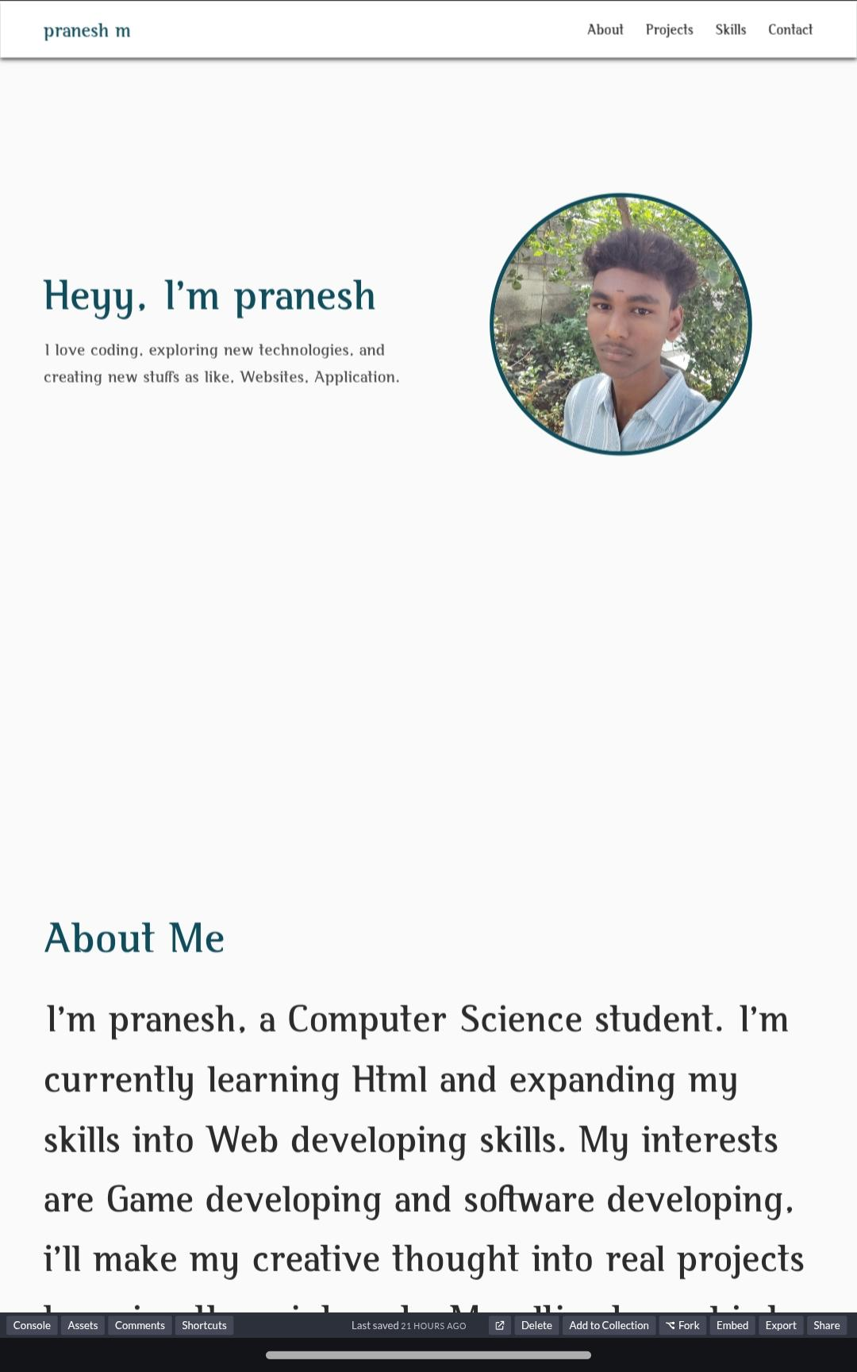
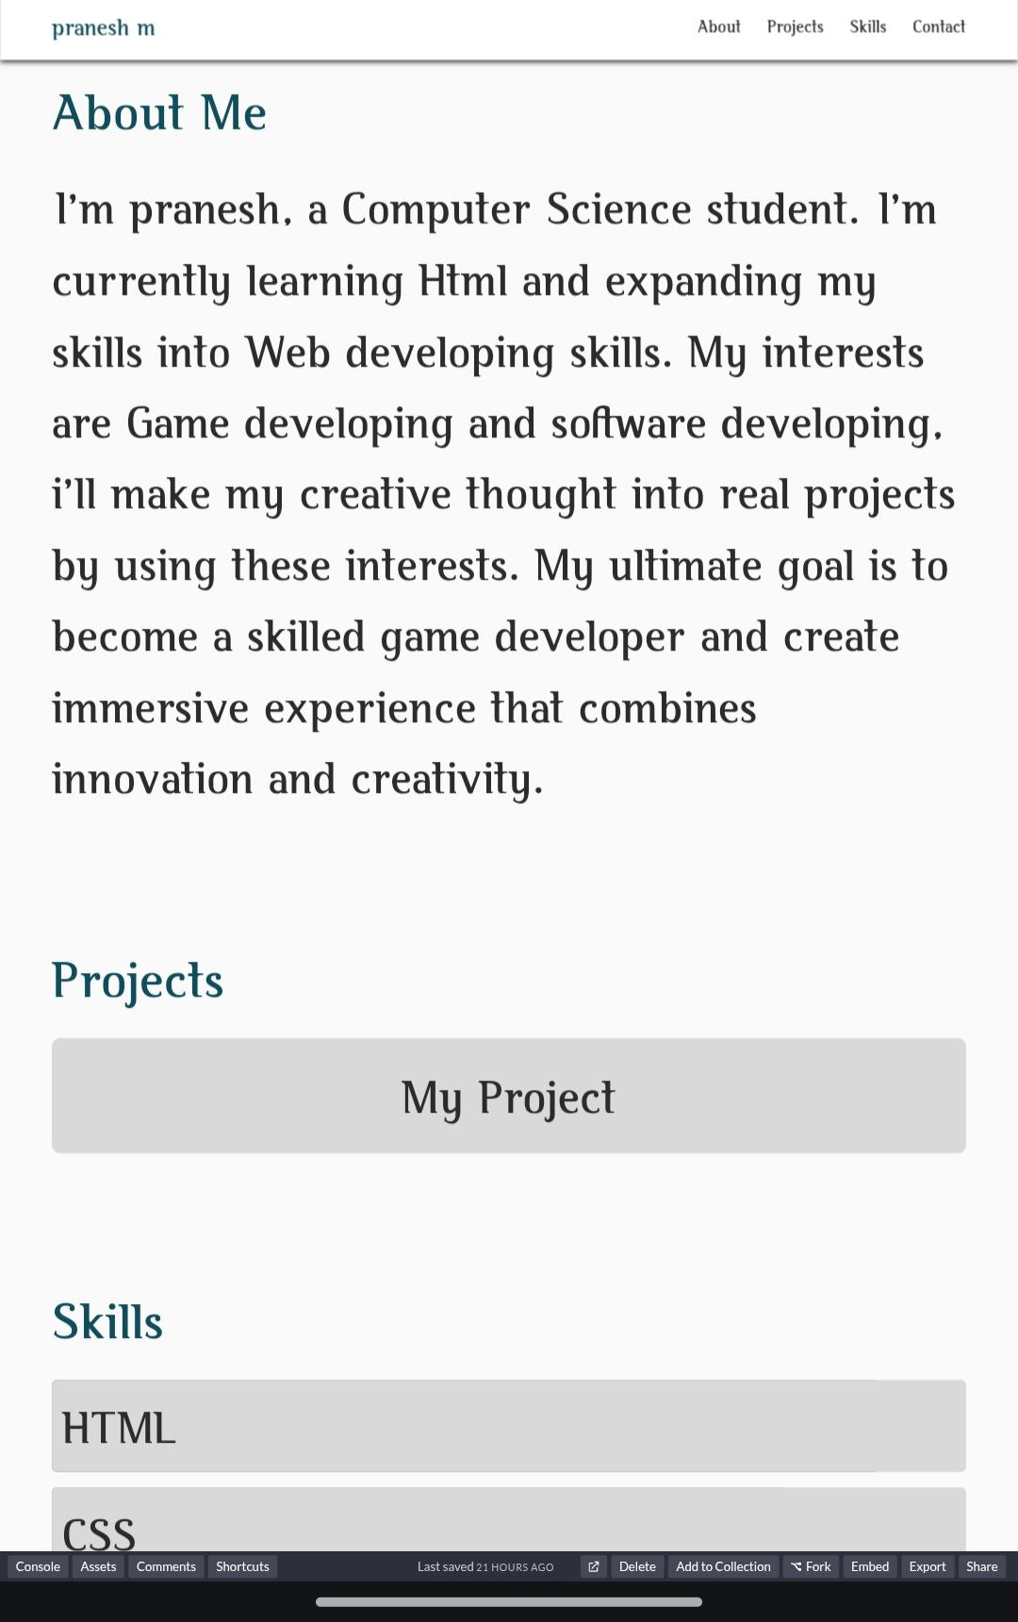
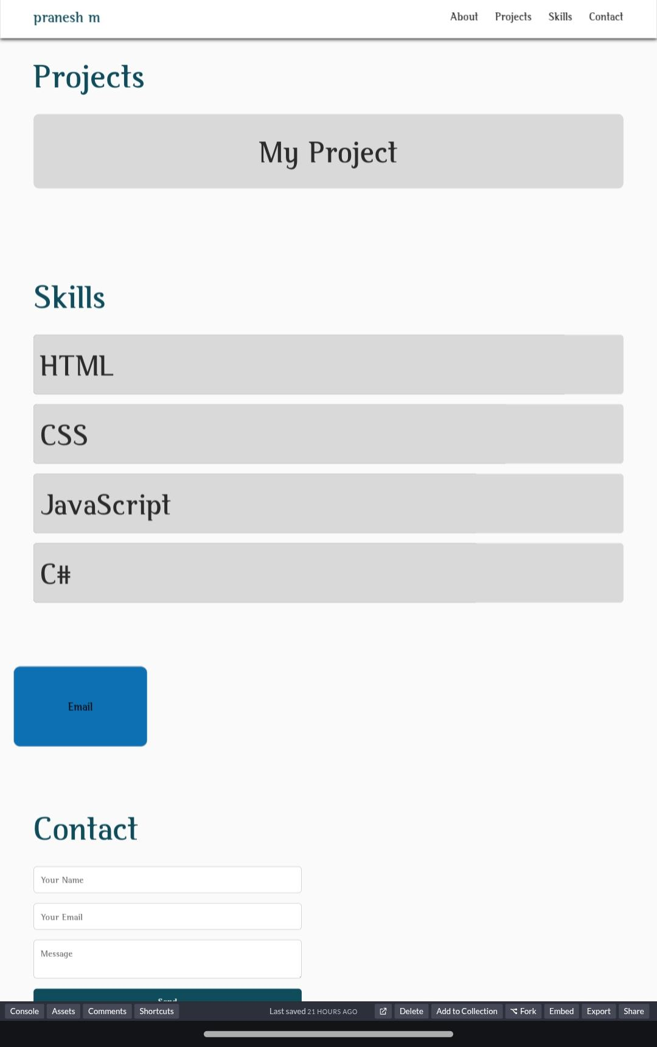
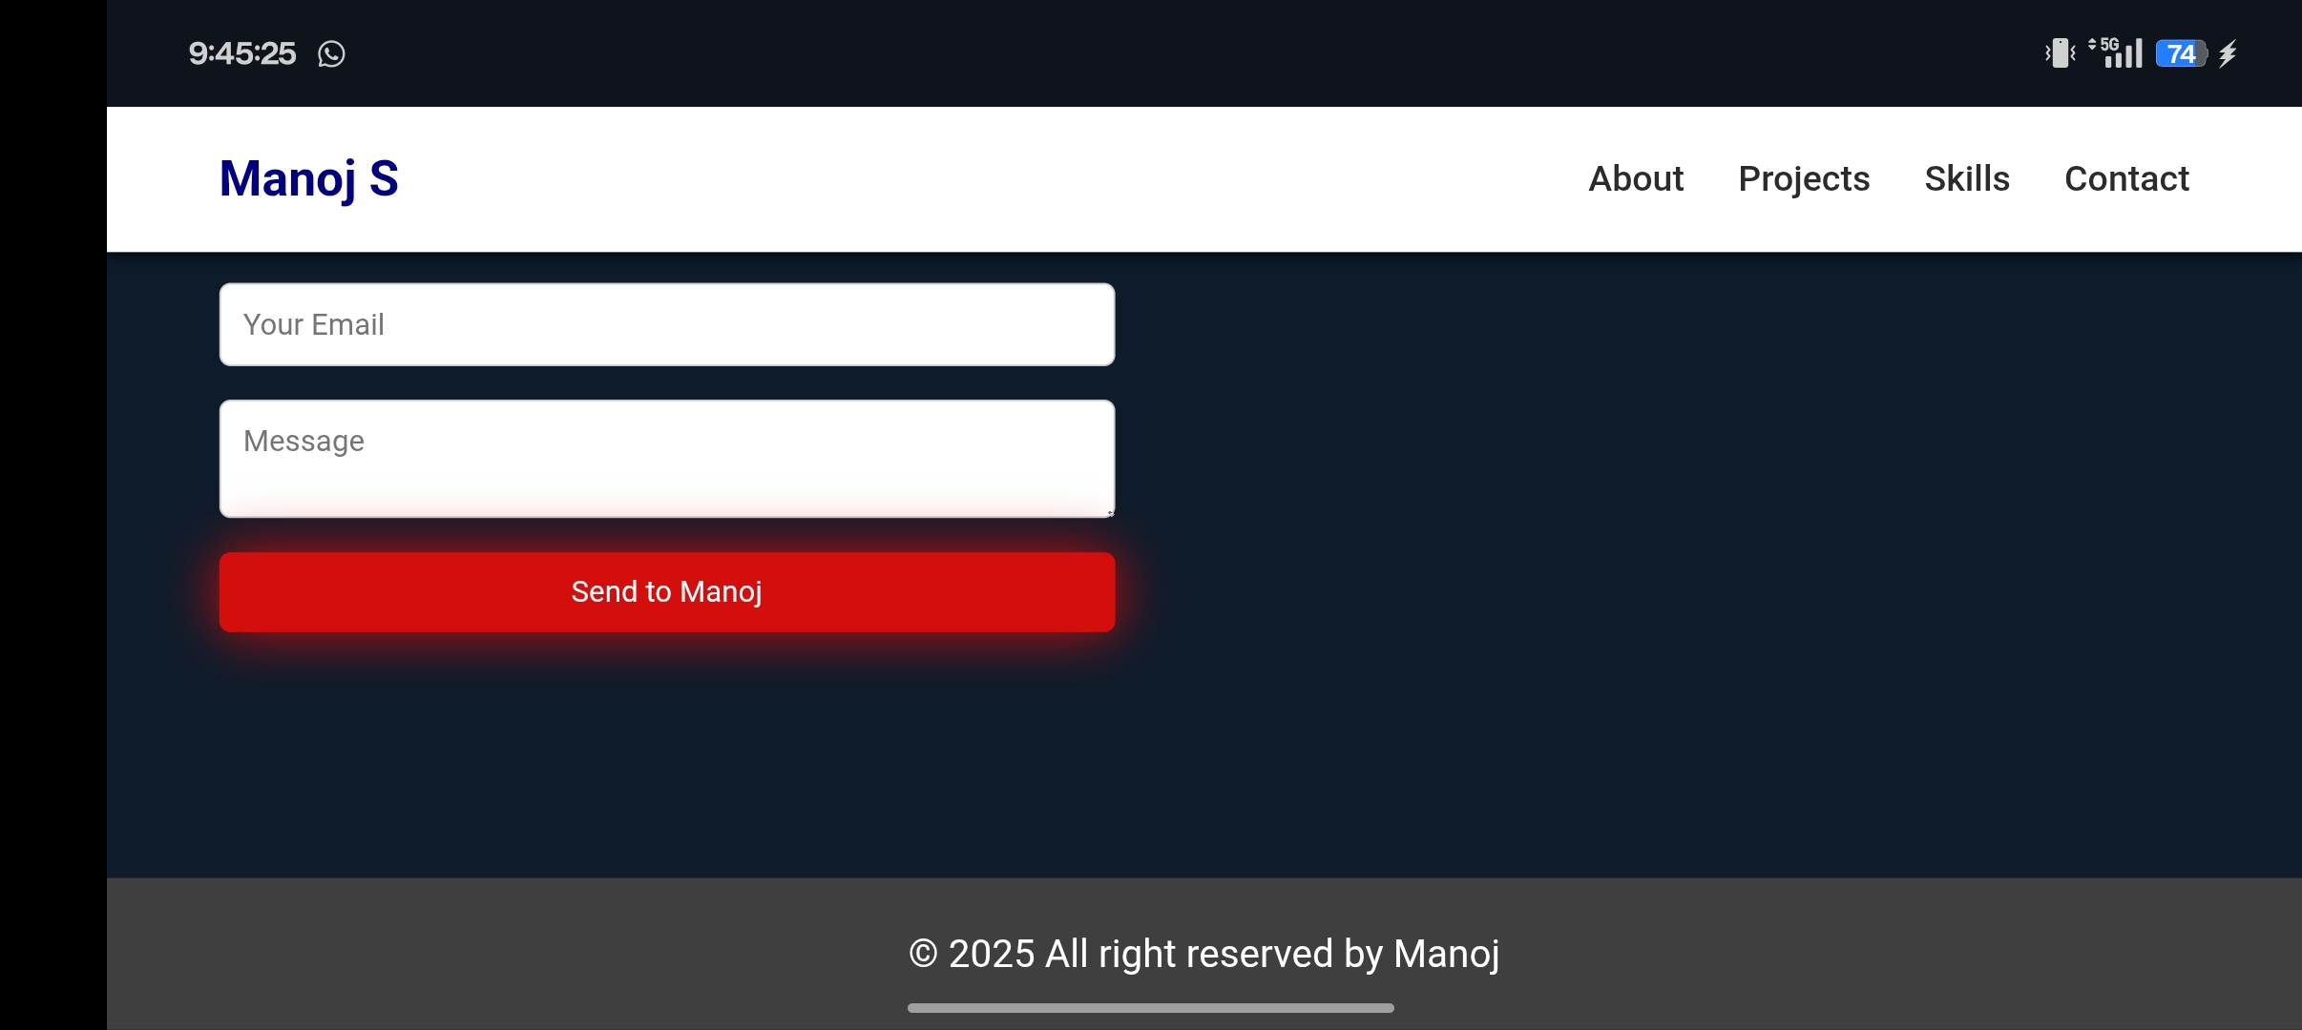

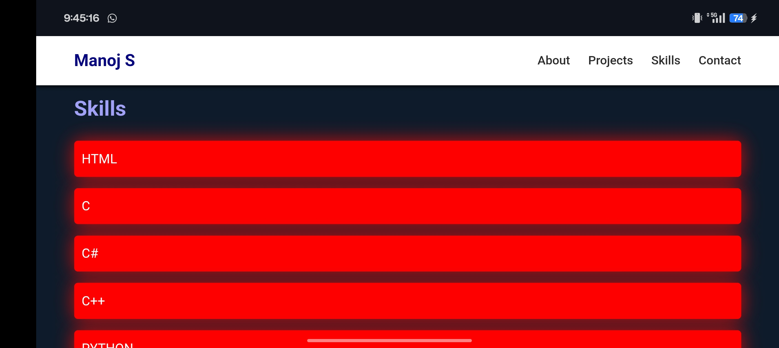
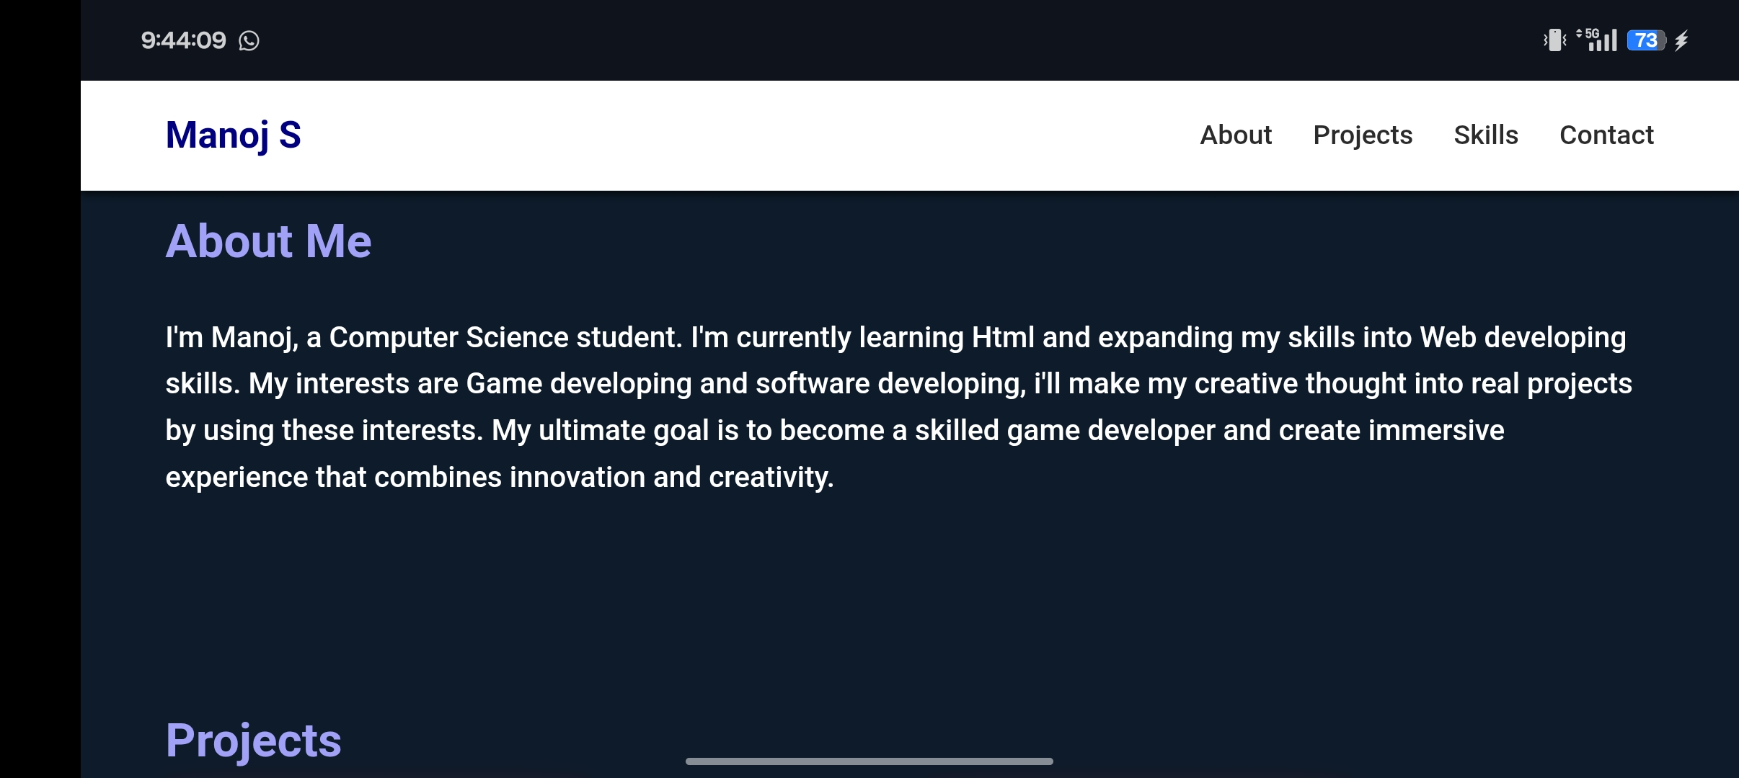
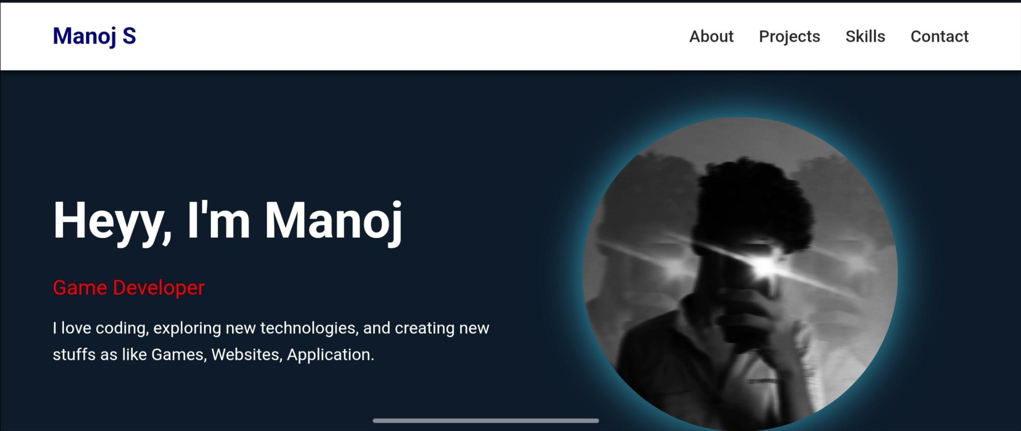
RESULTS AND SCREENSHOTS
Website successfully created and running Portfolio highlights my profile and projects Screenshots show working navigation, skills bar animation, and project links
3/21/2024 Annual Review
10

Slide 11
CONCLUSION
The digital portfolio helps me showcase my skills in a professional way. It is useful for job opportunities, internships, and networking. I also improved my knowledge in web development by building it.
11

